Slide 1
Find S Algorithm

Slide 2
Introduction to Concept Learning
Concept Learning
General Hypothesis
Specific Hypothesis
Any algorithm that supports concept learning requires the following:
Training Data
Target Concept
Actual Data Objects

Slide 3
Hypothesis
Hypothesis, in general, is an explanation for something.
The general hypothesis basically states the general relationship between the major variables.
For example, a general hypothesis for ordering food would be I want a burger.
G = { ‘?’, ‘?’, ‘?’, …..’?’}
The specific hypothesis fills in all the important details about the variables given in the general hypothesis.
The more specific details into the example given above would be I want a cheeseburger with a chicken pepperoni filling with a lot of lettuce.
S = {‘Φ’,’Φ’,’Φ’, ……,’Φ’}

Slide 4
Find S Algorithm and Flowchart
Load Data set
Initialize h to the most specific hypothesis in H
For each positive training instance x
• For each attribute constraint ai in h
If the constraint ai in h is satisfied by x
then do nothing
else replace ai in h by the next more general constraint
that is satisfied by x
4. Output hypothesis h

Slide 5
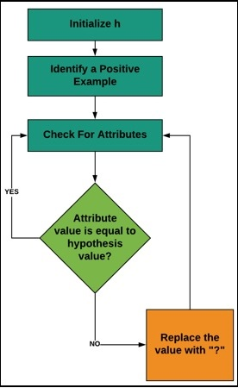
Flowchart

Slide 6
Modifying weights using Hebbian Rule
First iteration –
w(new) = w(old) + x₁y₁ = [ 0 0 0 ]^{T} + [ -1 -1 1 ]^{T} . [ -1 ] = [ 1 1 -1 ]^{T}
For the second iteration, the final weight of the first one will be
used and so on.
Second iteration –
w(new) = [ 1 1 -1 ]^{T} + [ -1 1 1 ]^{T} . [ -1 ] = [ 2 0 -2 ]^{T}
Third iteration –
w(new) = [ 2 0 -2]^{T} + [ 1 -1 1 ]^{T} . [ -1 ] = [ 1 1 -3 ]^{T}
Fourth iteration –
w(new) = [ 1 1 -3]^{T} + [ 1 1 1 ]^{T} . [ 1 ] = [ 2 2 -2 ]^{T}
So, the final weight matrix is [ 2 2 -2 ]^{T}

Slide 7
Find S Code
import csv
a = []
with open('ENJOYSPORT.csv', 'r') as csvfile:
for row in csv.reader(csvfile):
a.append(row)
print(a)
print("\n The total number of training instances are : ",len(a))
num_attribute = len(a[0])-1
print("\n The initial hypothesis is : ")
hypothesis = ['0']*num_attribute
print(hypothesis)
for i in range(0, len(a)):
if a[i][num_attribute] == 'Yes':
for j in range(0, num_attribute):
if hypothesis[j] == '0' or hypothesis[j] == a[i][j]:
hypothesis[j] = a[i][j]
else:
hypothesis[j] = '?'
print("\n The hypothesis for the training instance {} is : \n" .format(i+1),hypothesis)
print("\n The Maximally specific hypothesis for the training instance is ")
print(hypothesis)

